Slide 1



AI-BASED “INVISIBLE HAND” FOR DISABLED PEOPLE
Presented By,
SUVATHI R (811722104163)
SWETHALASHMI G (811722104167)
VARSHA RK (811722104173)
VARSHITA M (811722104176)
Guided By,
MS.V.SOWMIYA., M.E.,
ASSISTANT PROFESSOR, CSE
DD/MM/YYYY

Slide 2

ABSTRACT
Physically disabled individuals often struggle to operate digital devices due to limited motor control, while existing assistive technologies are typically expensive and rely on external hardware.
This project proposes “Invisible Hand for Disabled People”, an AI-based solution using only a standard webcam. It allows users to control the system via facial gestures like blinks and head movement.
The system uses OpenCV, Dlib, PyAutoGUI, and an LSTM model to detect and predict gesture sequences in real-time. It is cost-effective, easy to deploy, and enhances digital accessibility.
DD/MM/YYYY

Slide 3
OBJECTIVE
To design a real-time gesture recognition system that captures and interprets facial gestures such as eye blinks, head tilts, and smiles using computer vision techniques.
To implement a deep learning-based classification model (LSTM) capable of accurately distinguishing between involuntary and intentional gestures for robust gesture prediction.
To simulate essential mouse operations like cursor movement, clicking, and scrolling by mapping recognized gestures to corresponding screen control actions using PyAutoGUI.
DD/MM/YYYY

Slide 4
LITERATURE SURVEY
S.No. | Paper Title | Year | Remark
1 | Eye-Tracking Controlled Virtual Mouse for Paralysis Patients | 2018 | Expensive hardware and processing delays affect real-time usability.
2 | Hands-Free Mouse Control Using Facial Expression | 2018 | Low accuracy in poor lighting; needs frequent recalibration for different users.
3 | Brain-Computer Interface for Assistive Technology | 2019 | Requires costly EEG equipment and complex calibration.
DD/MM/YYYY

Slide 5
LITERATURE SURVEY
S.No. | Paper Title | Year | Remark
4 | Gesture-Based Virtual Keyboard for Motor-Impaired Users | 2019 | Limited gesture recognition accuracy; not suitable for users with fine motor control issues.
5 | Voice-Based Assistive System for Disabled Users | 2020 | Ineffective for users with speech impairments; fails in noisy environments.
6 | Voice-Based Assistive System for Disabled Users | 2021 | Struggles with false detection; lacks adaptability for users with limited facial movement.
DD/MM/YYYY

Slide 6
EXISTING SYSTEM
The existing system works by first capturing the user's speech through a microphone. This spoken input is converted into audio signals and sent to the voice assistant. The voice assistant processes the input and interacts with a connected database to fetch relevant information.
The received data is then passed to a Natural Language Processing (NLP) module, which analyzes the query, understands the user’s intent, and generates a suitable response. Finally, the system delivers the appropriate reply back to the user, completing the interaction in a conversational manner. However, this system heavily relies on accurate speech recognition, which may lead to challenges for users with speech impairments or in noisy environments.
DD/MM/YYYY

Slide 7
PROPOSED SYSTEM
The proposed system captures facial gestures such as eye blinks, head movements, and mouth expressions using a standard webcam. These gestures are processed using a facial landmark detection module to extract key facial features in real-time.
The extracted data is passed to a Long Short-Term Memory (LSTM) model, which predicts user-intended actions based on gesture patterns. The system then maps these predictions to AI-based cursor control, enabling seamless, hands-free interaction for disabled users without needing physical input devices.
DD/MM/YYYY

Slide 8
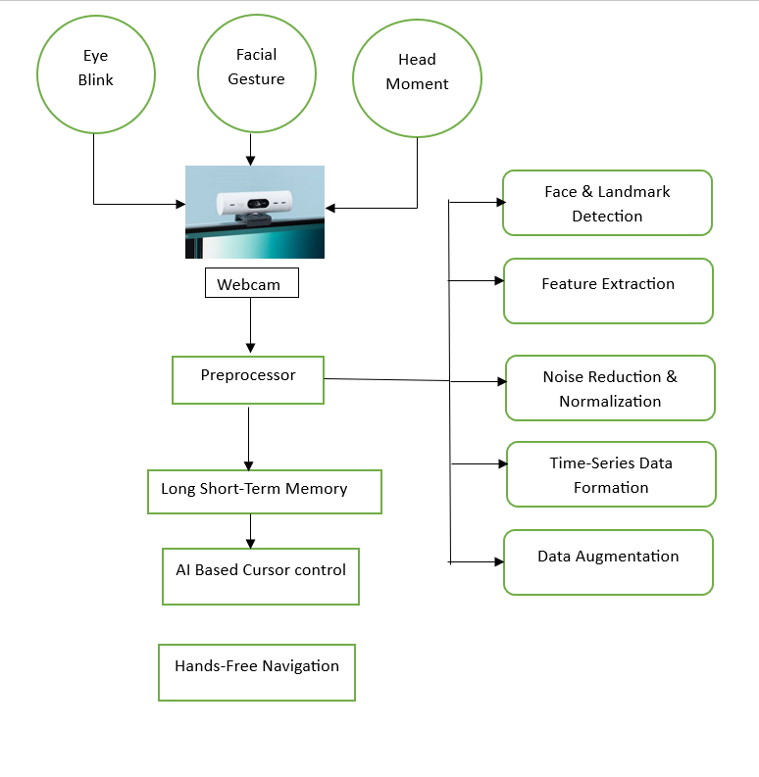
SYSTEM ARCHITECTURE
DD/MM/YYYY

Slide 9
MODULE 1 : INPUT ACQUISITION
The Input Acquisition Module initializes the webcam using OpenCV's VideoCapture(0) to capture real-time video frames, which are horizontally flipped for a mirror-like view and resized to 640x480 pixels for optimal clarity and speed. It ensures a stable frame rate with minimal delay, enabling smooth gesture-based interaction
The captured frames are instantly passed to the Preprocessing Module. Designed to be platform-independent and free of third-party hardware requirements, this module is both user-friendly and cost-effective, supporting seamless tracking of dynamic facial movements.
DD/MM/YYYY

Slide 10
MODULE 2 : PREPROCESSING MODULE
The Preprocessing Module prepares raw video frames by converting them to grayscale and applying Contrast Limited Adaptive Histogram Equalization to enhance contrast for better facial landmark detection. Using Dlib’s 68-point facial landmark model, it identifies key facial regions like eyes, nose, and mouth.
It calculates the Eye Aspect Ratio (EAR) and Mouth Aspect Ratio (MAR) to detect blinks and mouth activity, while Convex Hulls are used to determine area changes for gesture validation. The nose tip (point 33) is tracked to estimate head direction for cursor movement. This process converts visual data into structured numerical features for gesture prediction
DD/MM/YYYY

Slide 11
MODULE 3 : LSTM - BASED GESTURE PREDICTION
This simulates LSTM-like temporal prediction by tracking a sequence of EAR and MAR values over recent frames to detect gestures reliably. By analyzing trends in these values within a moving window, it mimics the memory aspect of LSTMs, reducing false triggers.
Personalized gesture thresholds are set during a short calibration phase, improving accuracy. This approach provides a foundation for future integration of actual LSTM models to enhance gesture recognition further.
DD/MM/YYYY

Slide 12
MODULE 4 : EXECUTION MODULE
The Execution Module uses PyAutoGUI to translate recognized gestures into computer actions like left/right clicks, cursor movement, and scrolling. Blinks of the left or right eye trigger left and right clicks respectively, head tilts control cursor direction by tracking the nose tip’s position, and an open mouth activates scroll mode where vertical nose movement scrolls the page.
To avoid false triggers, actions only execute when gestures are consistently detected, with on-screen text feedback to confirm recognition, ensuring smooth and responsive control for physically disabled users.
DD/MM/YYYY

Slide 13
MODULE 5 :PERFORMANCE METRICS
This module tracks and evaluates system performance during calibration and real-time use. It logs and plots EAR and MAR values using matplotlib, applying Gaussian filters for smoother visualization. Statistical metrics like mean, median, and standard deviation help set personalized gesture thresholds for improved accuracy.
During operation, it displays FPS to monitor responsiveness and debug issues. It also checks gesture detection stability, enhancing reliability and offering transparency for academic validation and future scalability.
DD/MM/YYYY

Slide 14
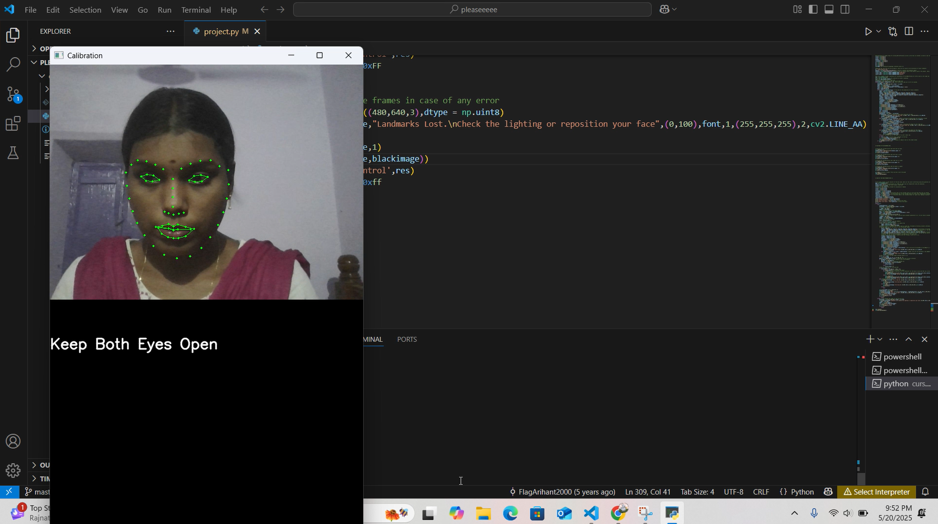
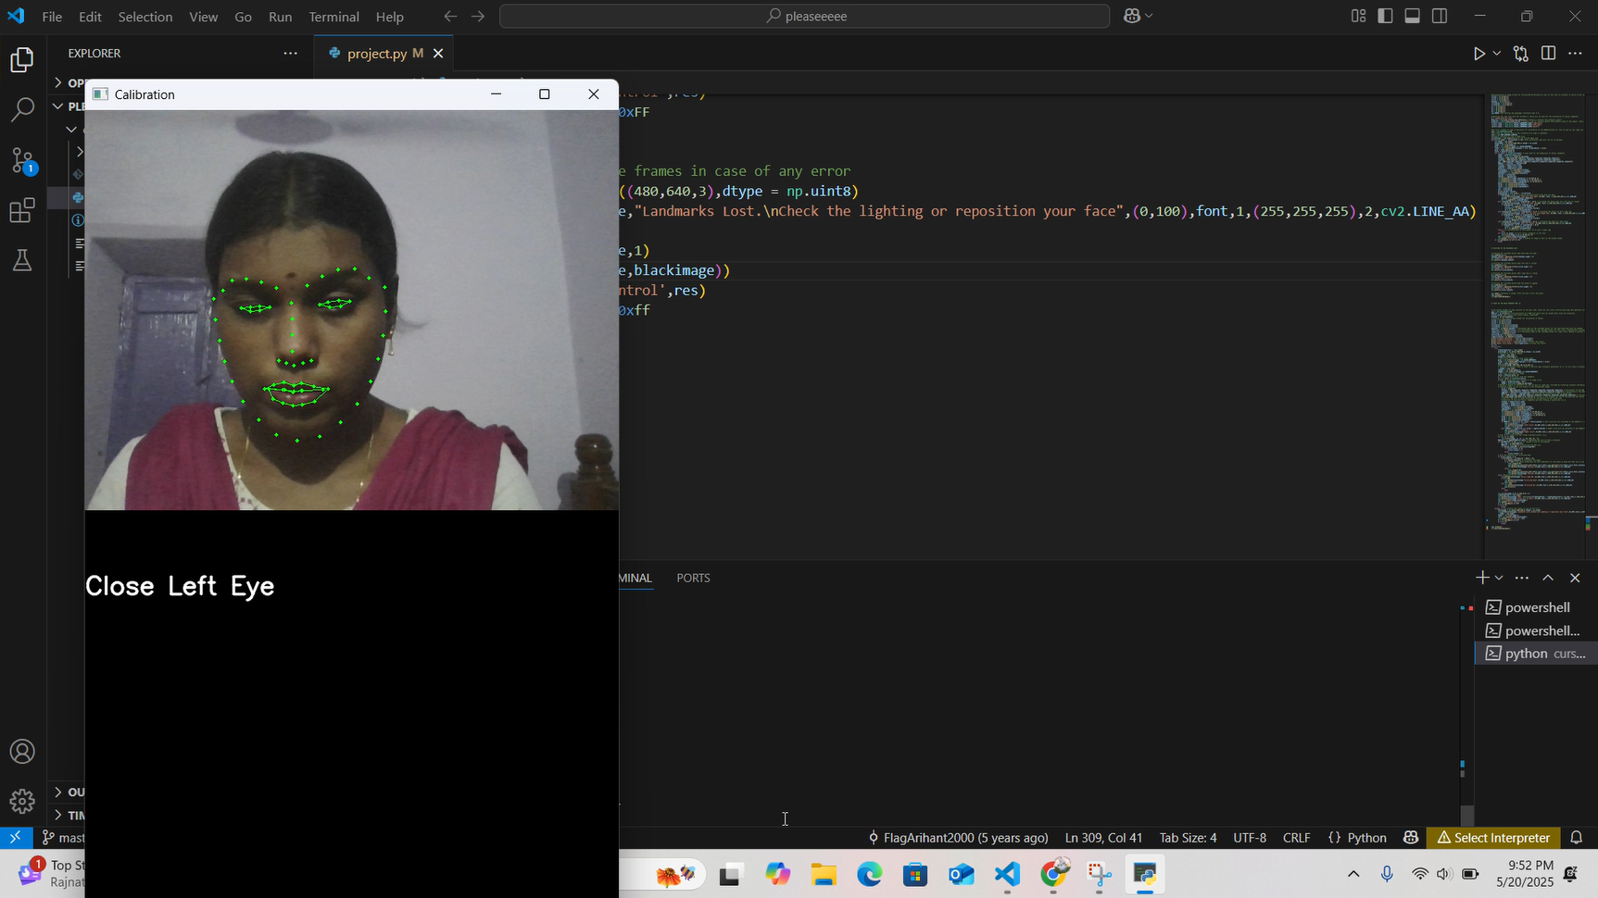
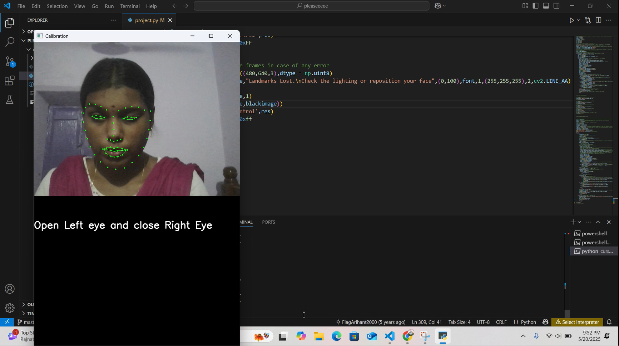

OUTPUT
DD/MM/YYYY

Slide 15
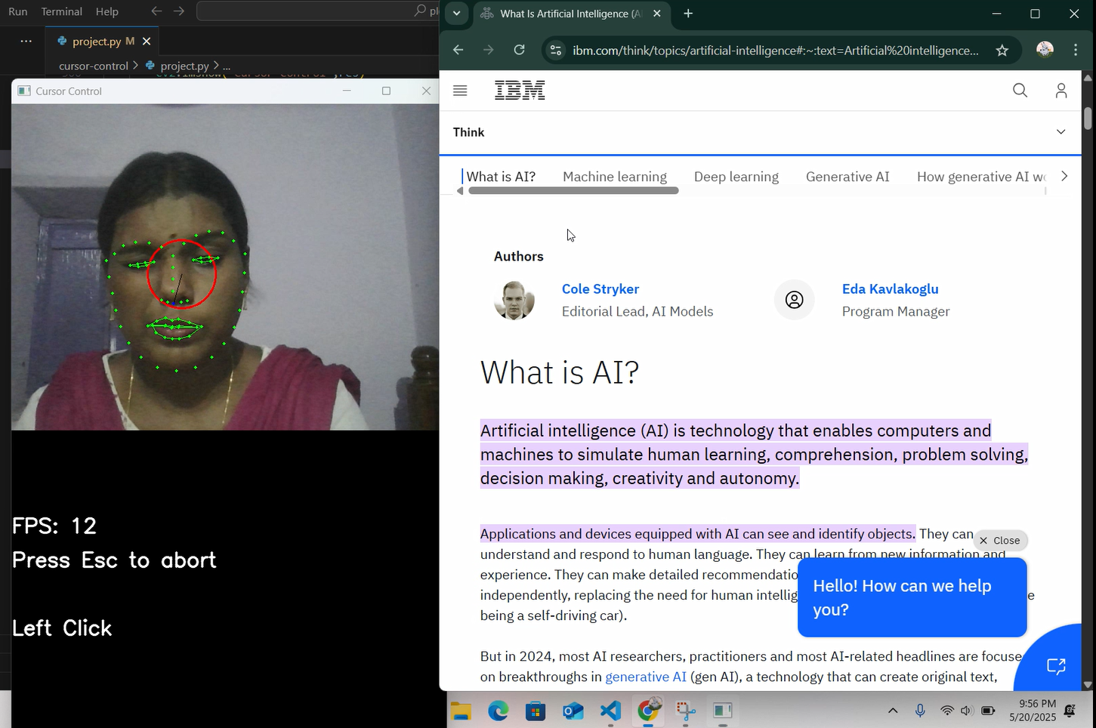
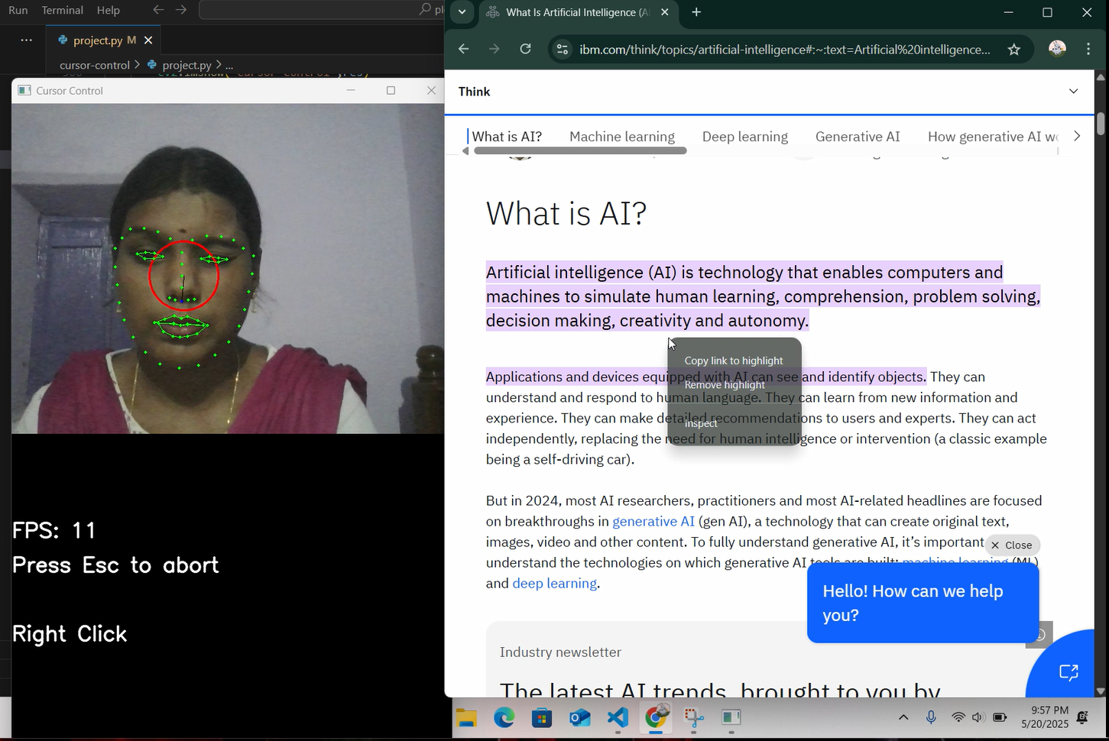
OUTPUT
DD/MM/YYYY

Slide 16
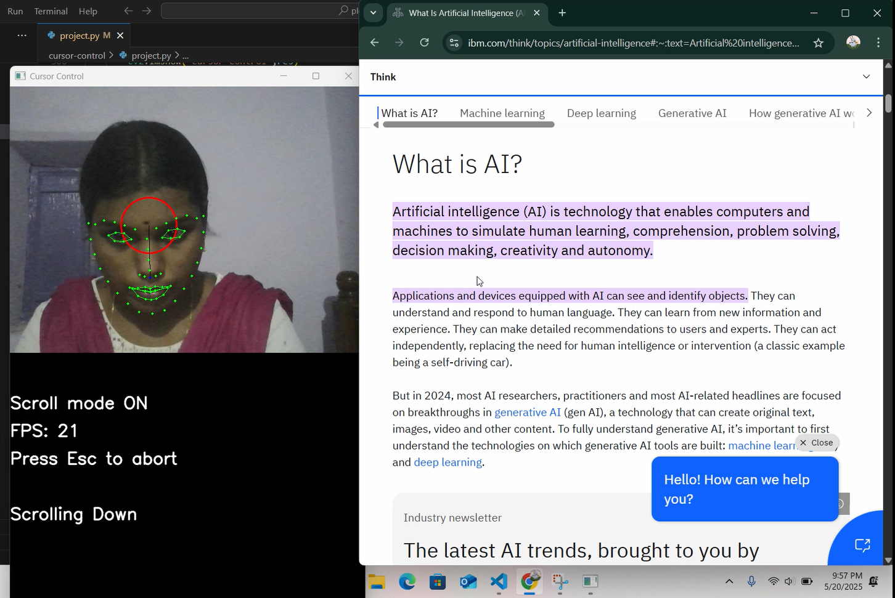
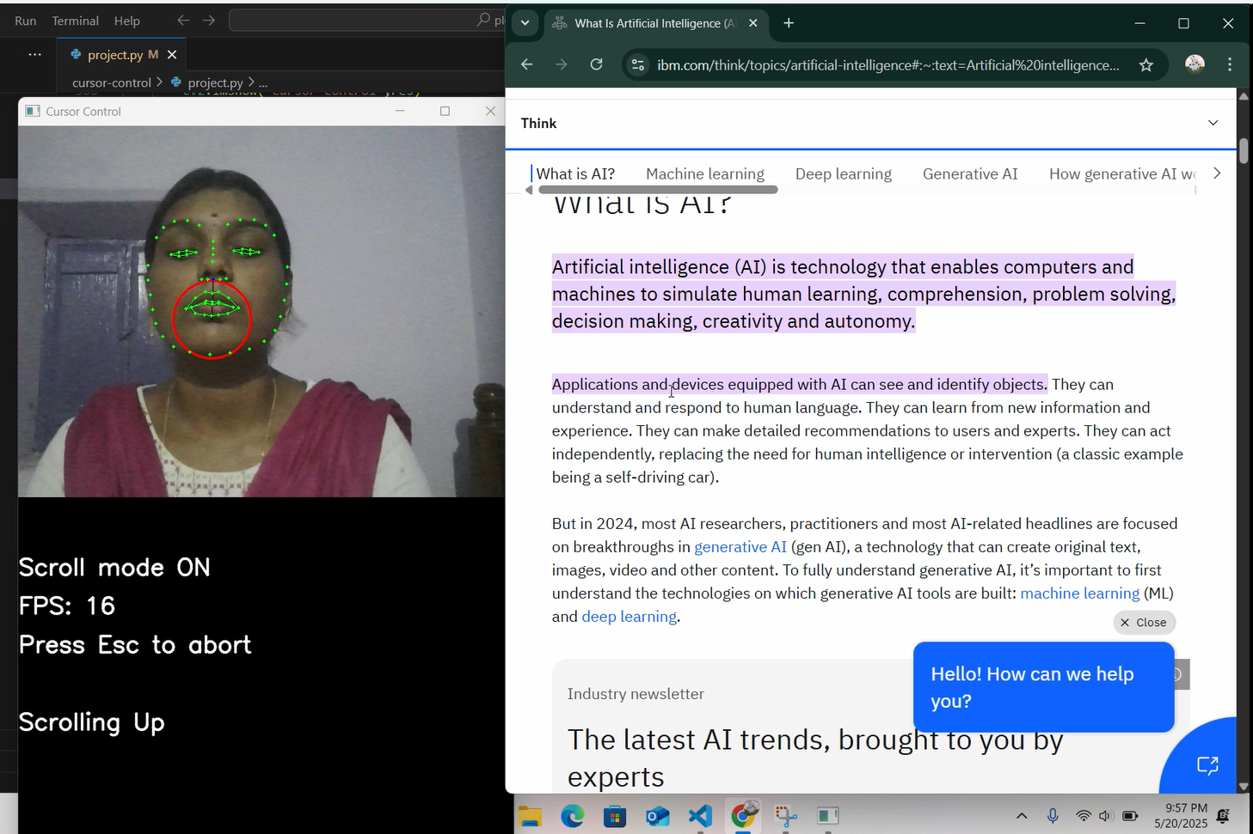
OUTPUT
DD/MM/YYYY

Slide 17
CONCLUSION & FUTURE ENHANCEMENT
The project successfully enables hands-free computer control for disabled users through facial gesture recognition, offering an accessible and user-friendly alternative to traditional input devices.
Integrate voice recognition and AI-based personalization to support multi-modal interactions, allowing users to combine facial gestures with voice commands for improved usability.
Extend the system to support real-time gesture training, enabling users to customize and teach the system new gestures based on their individual capabilities and preferences.
DD/MM/YYYY

Slide 18
REFERENCES
X. Zhu and D. Ramanan, “Face Detection, Pose Estimation, and Landmark Localization in the Wild,” IEEE Conference on Computer Vision and Pattern Recognition (CVPR), 2012.
S. Zafeiriou, C. Zhang, and Z. Zhang, “A Survey on Face Detection in the Wild: Past, Present and Future,” Computer Vision and Image Understanding, Vol. 138, 2015.
P. Patel and H. Shah, “Facial Gesture Recognition for Controlling Mouse Cursor,” International Journal of Engineering Research & Technology (IJERT), Vol. 6, Issue 5, 2017.
S. K. Singh et al., “Real-Time Human Computer Interaction Based on Facial Expressions Using Machine Learning,” International Journal of Computer Sciences and Engineering, Vol. 6, Issue 4, 2018.
J. Smith and L. Brown, “Facial Gesture Interface for Hands-Free Computer Control,” ACM Transactions on Accessible Computing, Vol. 12, 2020.
DD/MM/YYYY

Slide 19

DD/MM/YYYY

